Slide 1


New Year Sales Analysis Project
This project analyzes New Year sales data to uncover patterns, trends, and insights that reveal customer behavior. Using Python libraries like pandas, numpy, matplotlib, and seaborn, the dataset was loaded, cleaned, and explored to prepare for analysis.
The dataset contains 11,239 entries with details on user demographics, product categories, orders, and purchase amounts. Data cleaning included converting the Amount column to integer and verifying no null values remain.
by Shubham Raut

Slide 2
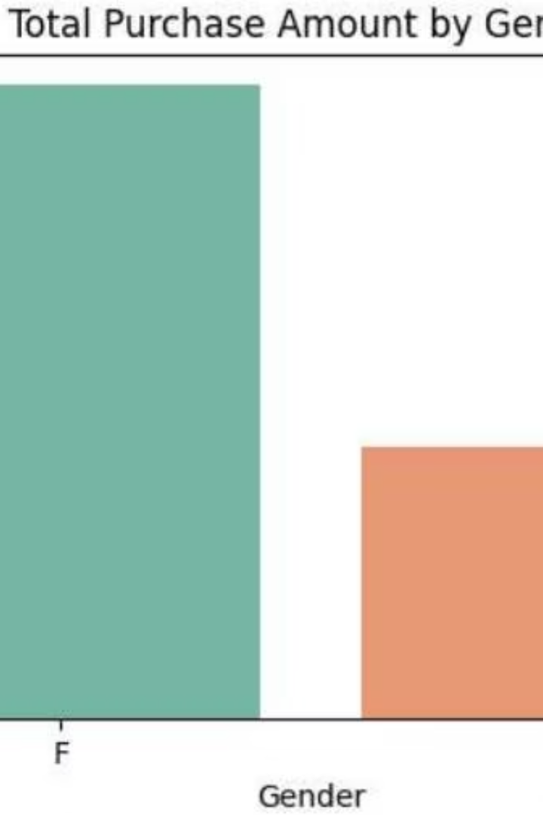
Gender and Purchase Amount Analysis
Purchase Participation
Both males and females participate nearly equally in purchases during the New Year sales.
Spending Patterns
Males contribute a higher total purchase amount, indicating they tend to spend more per transaction on average.

Slide 3
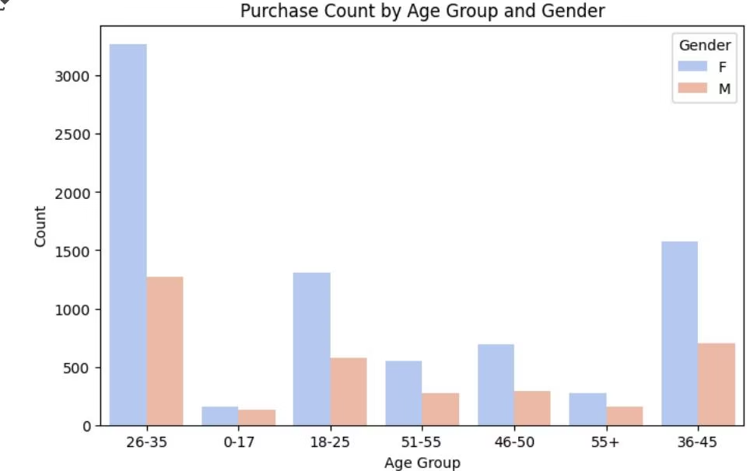
Age Group Purchase Trends
Most Active Age Group
Gender Differences
The 26-35 age group is the most active in making purchases during the New Year sales.
Within age groups, males generally show higher purchase counts and amounts compared to females.

Slide 4
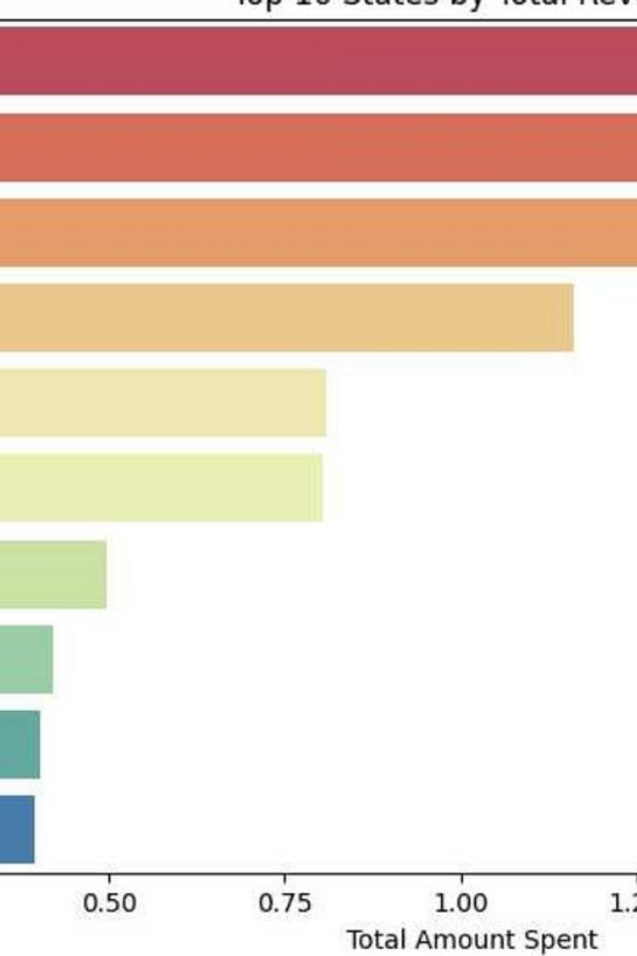
Top States by Purchase Amount
Leading States
Uttar Pradesh, Maharashtra, and Karnataka are the top three states generating the highest total revenue.
Revenue Concentration
These states together contribute nearly half of the overall sales revenue during the New Year period.

Slide 5
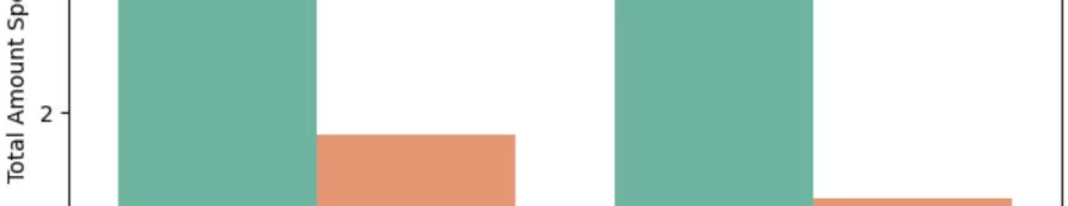


Marital Status and Spending
Married Individuals
Family Influence
Married customers tend to spend more overall compared to unmarried ones, especially married men.
This trend suggests family-related shopping drives higher purchase amounts during the New Year season.

Slide 6
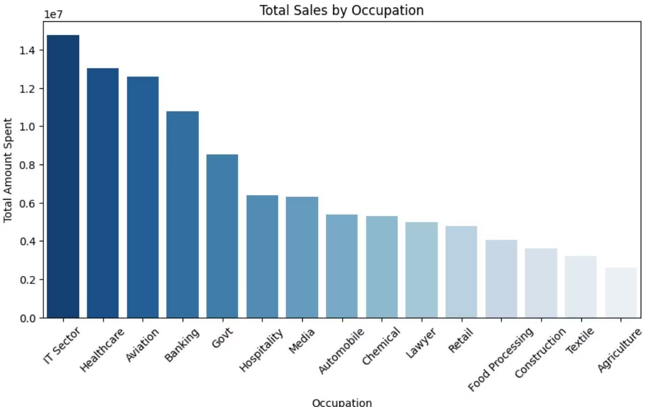
Occupation and Sales Contribution
Order Counts
Sales Volume
Working professionals and healthcare workers place the most orders during the New Year sales.
These occupations also contribute the highest total purchase amounts, likely due to better income levels.

Slide 7
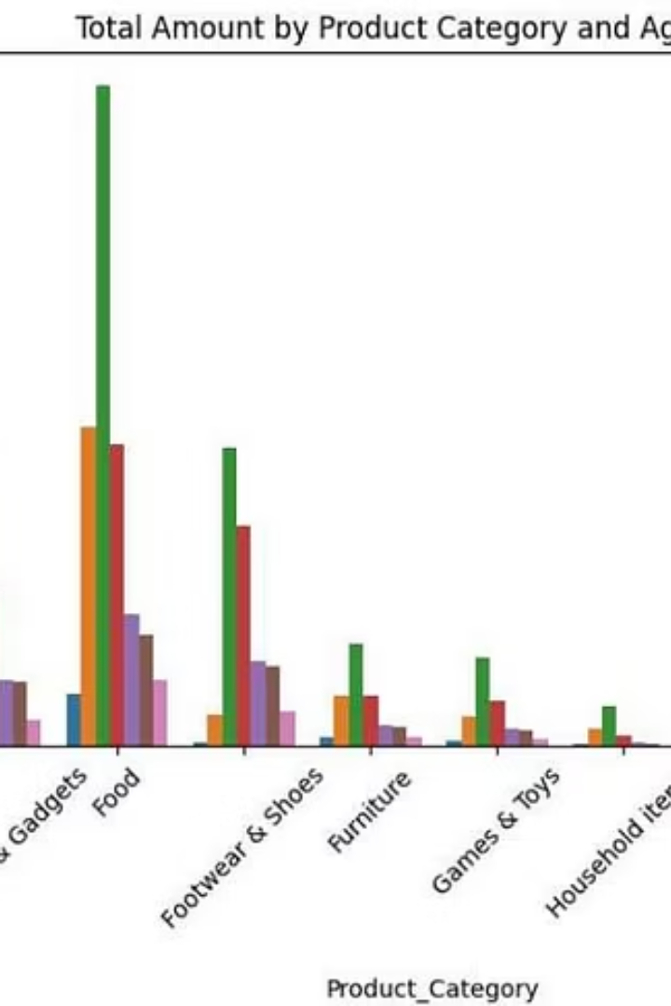


Product Category Preferences by Age and Gender
Age Group 26-35
Gender Variation
This age group contributes the most to purchases across all product categories.
Males generally spend more than females in each product category during the New Year sales.

Slide 8

Summary and Customer Profile
Key Insights
Men aged 26-35, especially married individuals, dominate purchase activity and spending.
Top Locations and Occupations
Uttar Pradesh, Maharashtra, and Karnataka lead in sales; working professionals and healthcare workers contribute most.
Product Preferences
Electronics, clothing, and food are the most popular categories with high purchase values.

